Slide 1

Anaconda
How to install Anaconda and Access Jupyter Notebooks

Slide 2
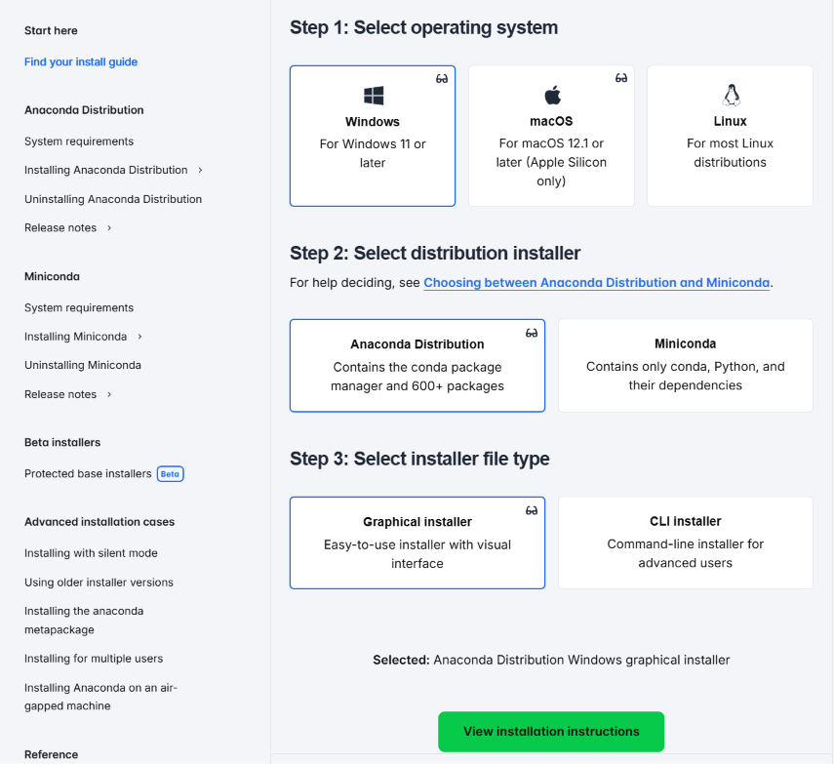

1. Go to this website and click on your Operative System. Then click on “View Installation Instructions”
Find your install guide - Anaconda

Slide 3
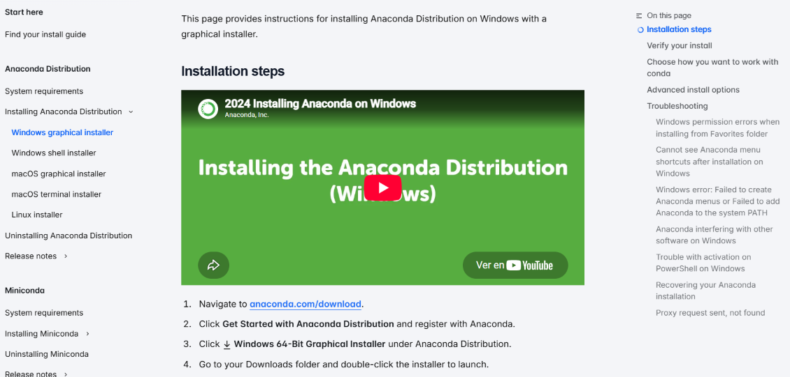
2. Once in there click on “Download”

Slide 4

3. Then click on “Skip to download”

Slide 5
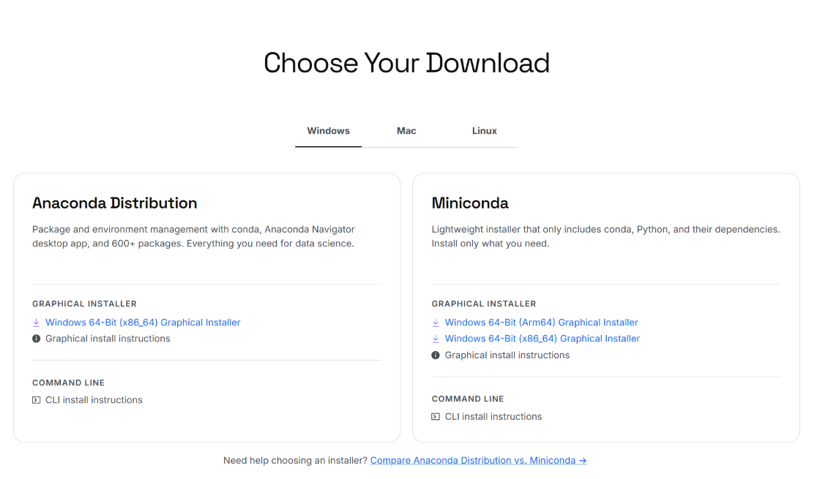
4. Then click on your Operating System, Anaconda Distribution (not miniconda)

Slide 6
And now you should have Anaconda Installed in your computer!

